Slide 1
Crime Trends in Austin: Seasonal Insights from 2003 to 2023
By: Julie, Prashant and Sarah

Slide 2
Resources
CSV Source: https://data.austintexas.gov/Public-Safety/Crime-Reports/fdj4-gpfu/about_data
Python Documentation and Tutorials
Python Libraries and Packages
Development Tools: Visual Studio Code
Version Control: Git and Github
Collaboration and Communication: Slack and Zoom
Instructional Staff: Travis Hopkins (Instructor)
Kian Layson (TA)

Slide 3
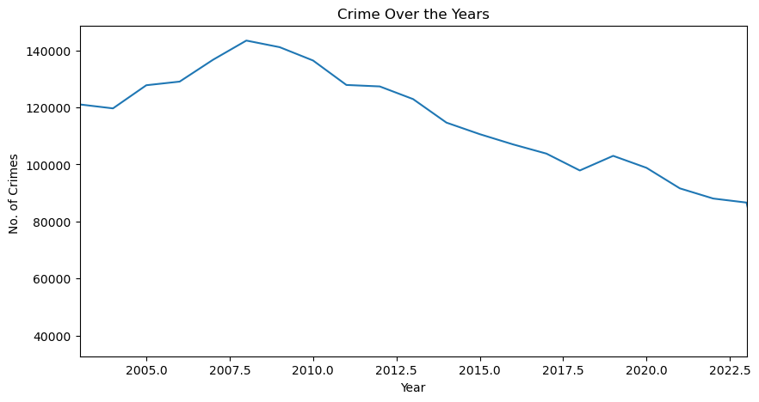
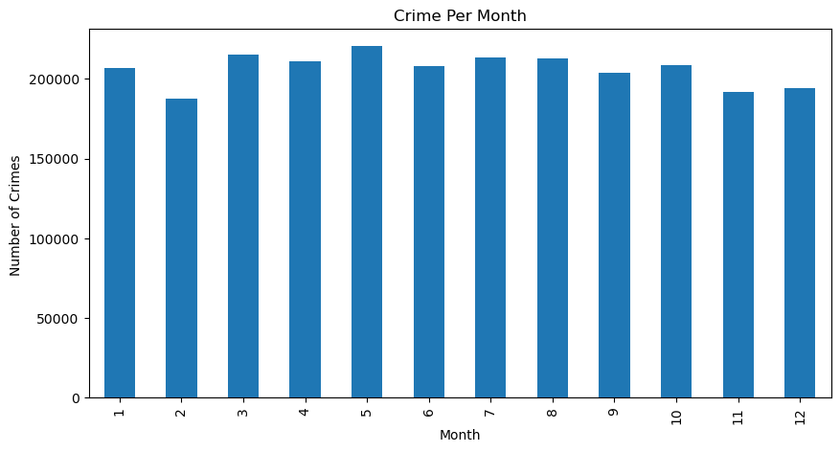
Basic Analysis
From the bare eye, the months look evenly distributed when it comes to crime in general
Sole curiosity… crime analysis over the years in Austin, TX
Notes:
Sole curiosity… crime analysis over the years in Austin, TX
From the bare eye, the months look evenly distributed when it comes to crime in general

Slide 4
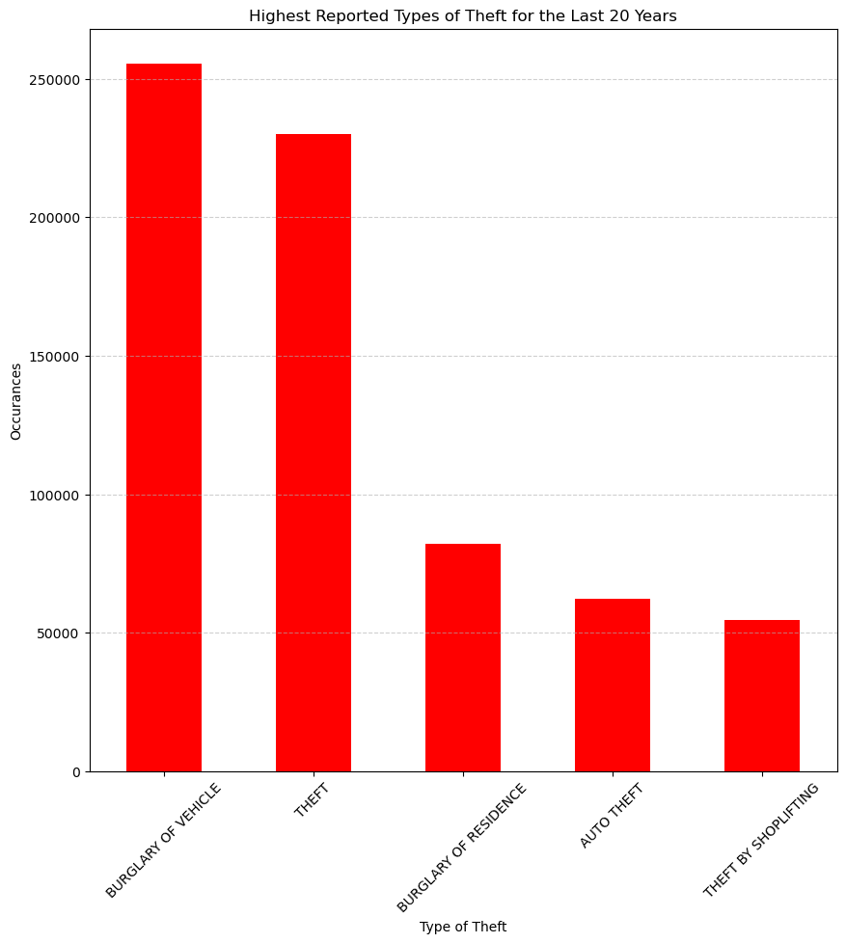
Focus In
Which types of theft crimes were reported the most?
Critical value =7.814727903251179

Slide 5
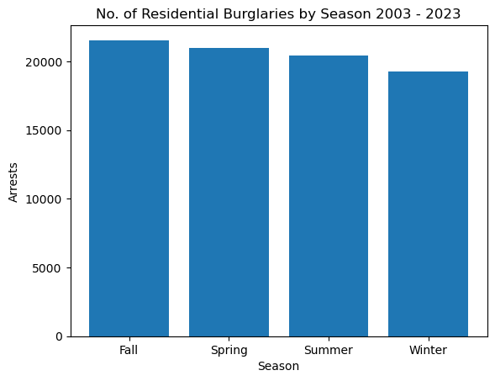
Residential Burglaries by Season
Looks to be less in the Winter
Chi-Square Statistic: 68.10559048133163
p-value: 1.0860061995797653e-14
With a very high chi-square value and a very low p-value this tells us that we can reject the null hypothesis and say
SEASON COULD DEFINITELY BE AFFECTING THE NUMBER OF RESIDENTIAL BURGLARIES

Slide 6
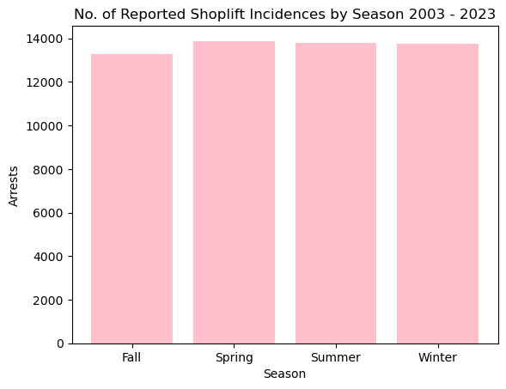
Shoplifting
Pretty even, but maybe less in the fall
Chi-Square Statistic: 8.155594276196815
P-value: 0.04290314382794721
Chi-Square number is still above the critical value, and P-Value is still lower than 0.05. Although, the values are closer than the other topics of study.
SEASON COULD DEFINITELY BE AFFECTING THE NUMBER OF SHOPLIFTING

Slide 7
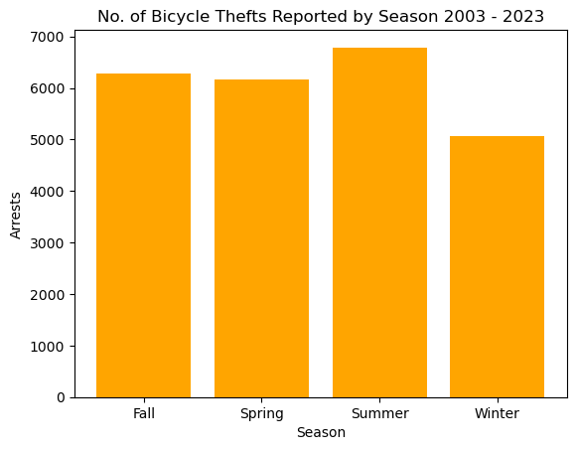
Bicycle Thefts
Low In The Winter
High In The Summer
Chi-Square Statistic: 133.9015818401975
P-value: 7.801563909349704e-29
With a very high chi-square value and a very low p-value this tells us that we can reject the null hypothesis and say
SEASON COULD DEFINITELY BE AFFECTING THE NUMBER OF BICYCLE THEFTS

Slide 8
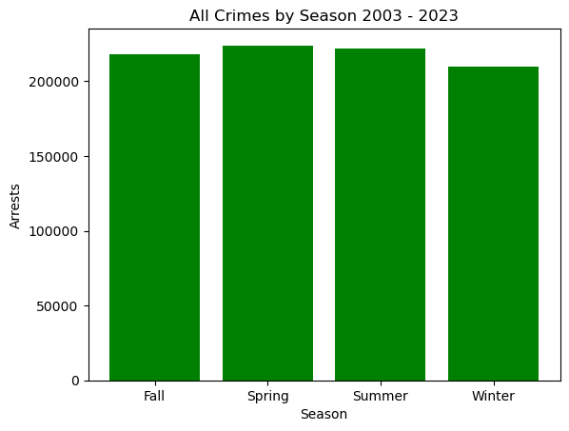
ALL CRIMES BY SEASON CHI SQUARE TEST
Chi-Square Statistic: 280.6044358946858
P-value: 1.566923504984882e-60
REJECT NULL HYPOTHESIS
This means.. Season could be having an impact on crime rate!!

Slide 9
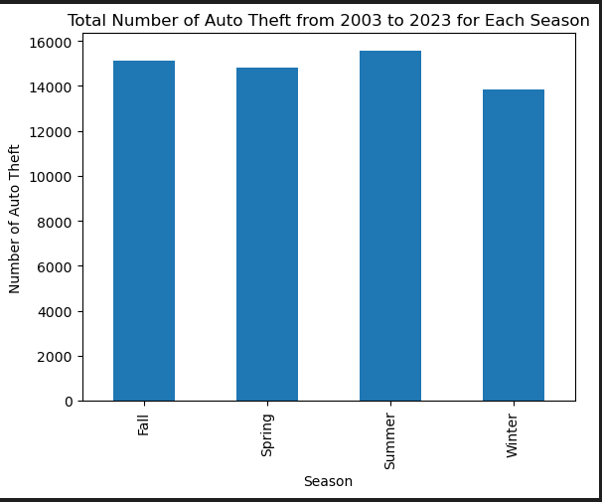
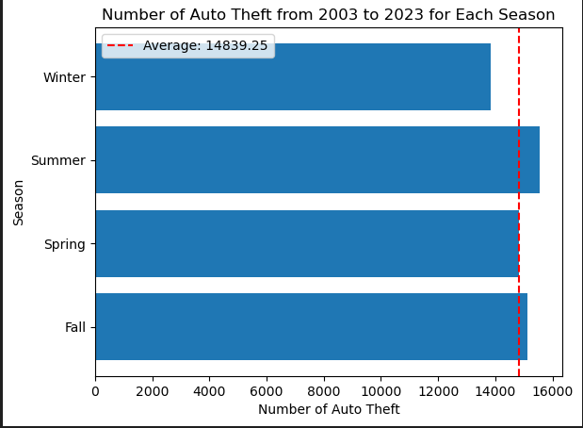
Auto Theft
Overall Data & Seasonal Average

Slide 10
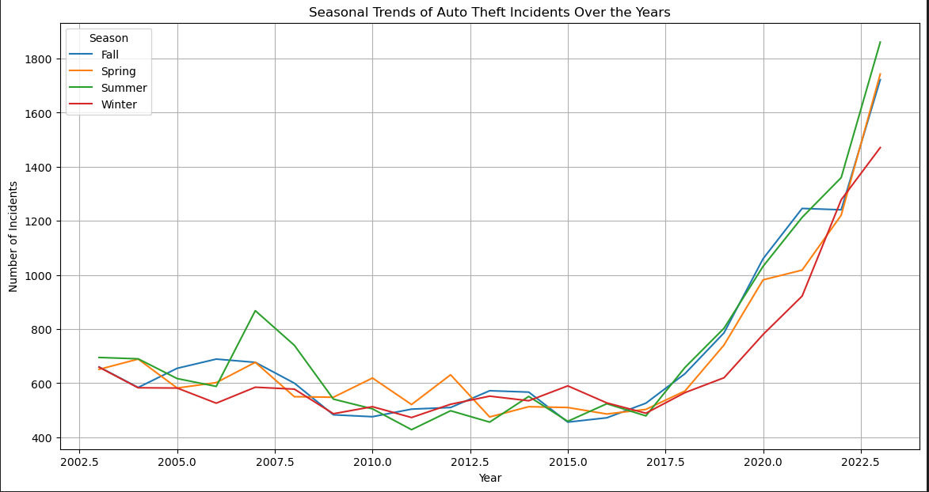

Slide 11
Test 4: Auto Theft across Seasons
N0: If seasons are not related to Auto theft, then particular seasons will not see an increase in identity theft.
N1: If seasons are related to auto theft, then particular seasons will show an increase in identity theft.
Results:
Chi-squared test: 55.05
P-value: 6.69
Reject null hypothesis: Seasons do influence auto theft

Slide 12
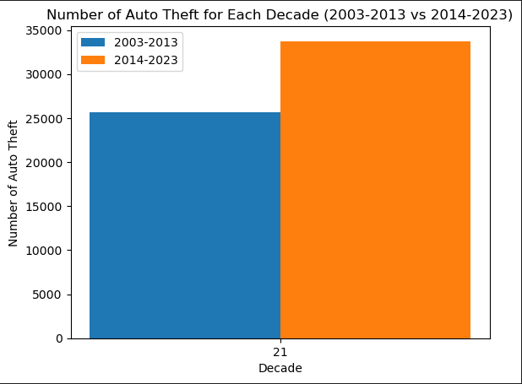
Comparison of Occurrences by Decade

Slide 13
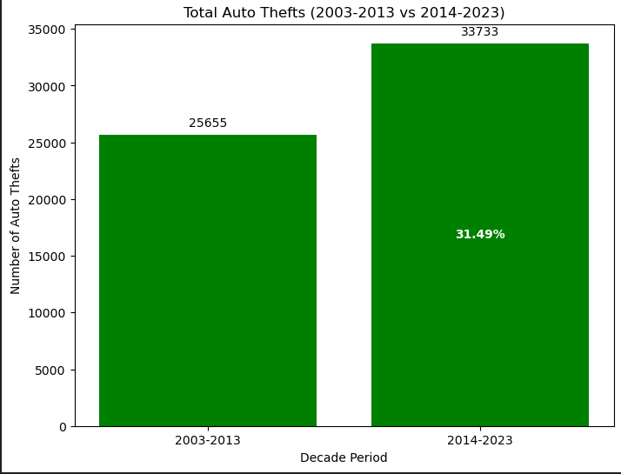
Increase in Number of Occurrences Compared to Previous Decade

Slide 14
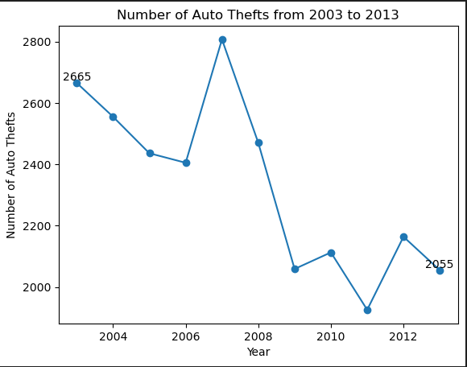
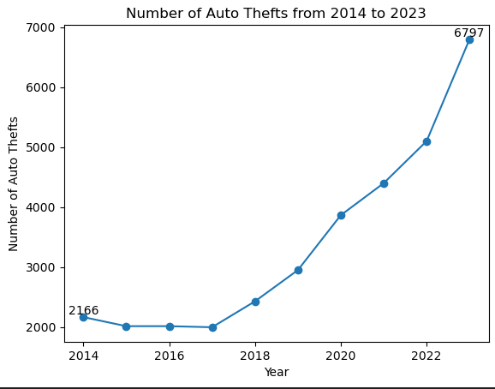
Comparison of Occurrences Between Two Ten Year Periods
Auto Thefts Between 2003-2013 -22.89% of 25,655 Total Occurrences
Auto Thefts Between 2014-2023 +213.80% of 33,733 Total Occurrences

Slide 15
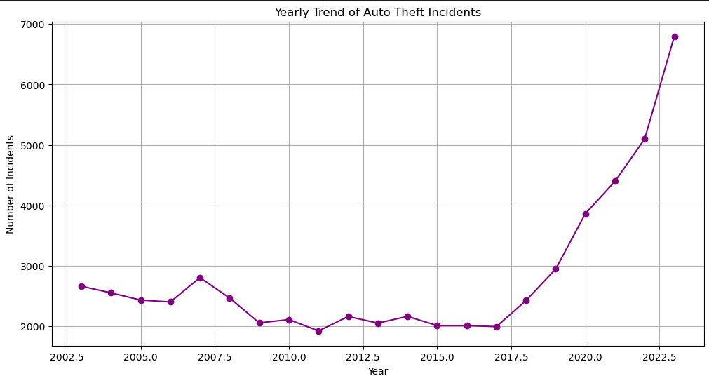
Total Percentage Increase in Auto Theft
Occurrences is approximately +155.05% over 20 Year Period

Slide 16
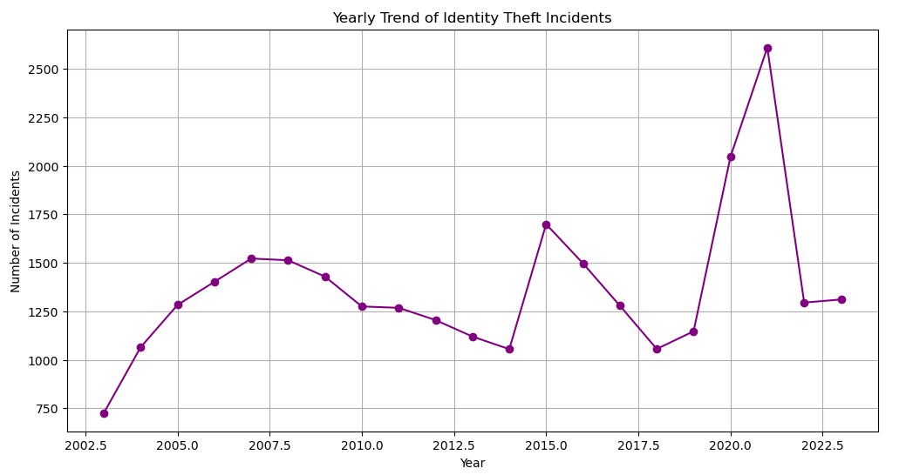
Identity Theft Over the Years

Slide 17
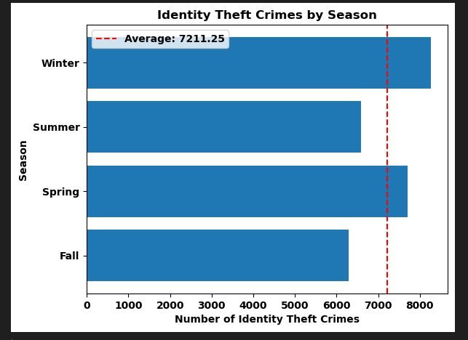
Identity Theft per Season
N0: If seasons are not related to identity theft, then the Winter months will not see an increase in identity theft.
N1: If seasons are related to identity theft, then the Winter months will show an increase in identity theft
Results:
Chi-squared test: 164.8933382489
P-value: 1.6107138924223533e-35
Reject null hypothesis: Seasons are related to identity theft.

Slide 18
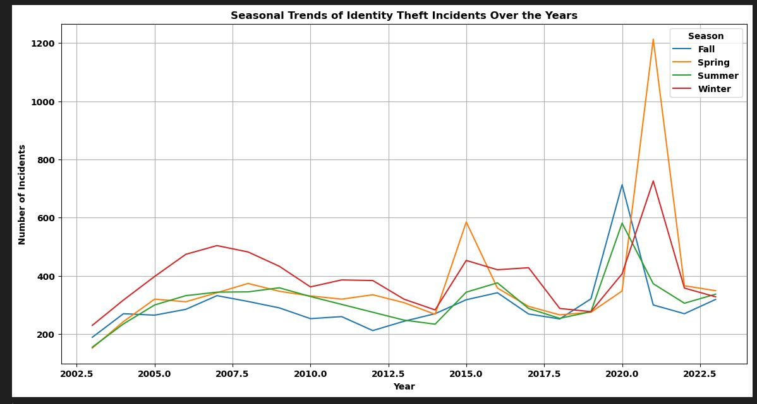
Identity Theft per Season

Slide 19
Overall Conclusion
Seasons do influence crime in residential burglaries, auto thefts, bicycle thefts, and identity theft.
Seasons do NOT impact shoplifting incidences

